Slide 1

Цифровая и микроконтроллерная техника
Vlasov Sergey
smvlasov@itmo.ru

Slide 2

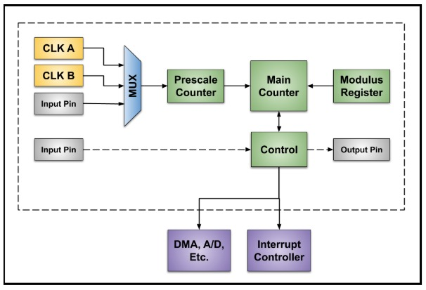
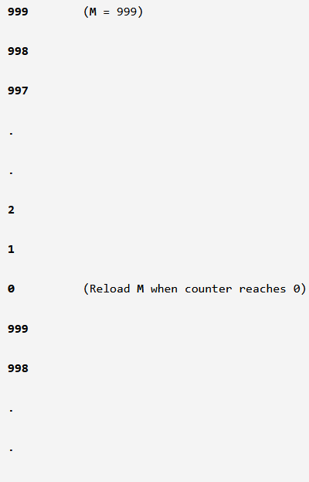
Timer

Slide 3
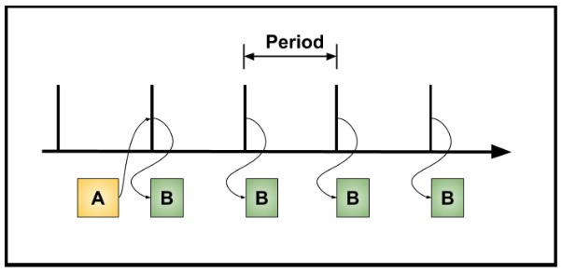
Periodic Timers

Slide 4
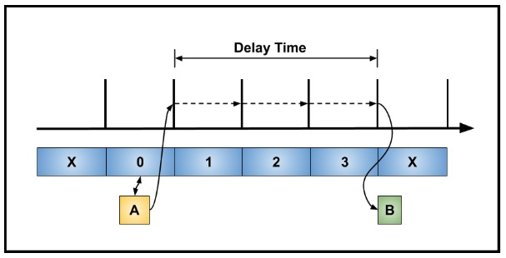
Delay

Slide 5
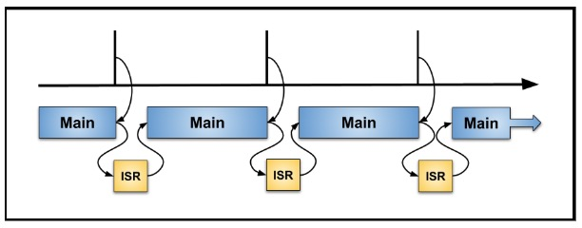
Polling and Interrupts

Slide 6
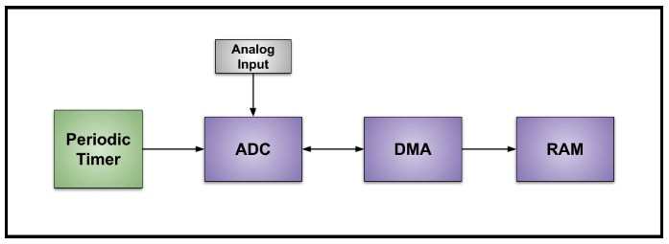
Triggering

Slide 7
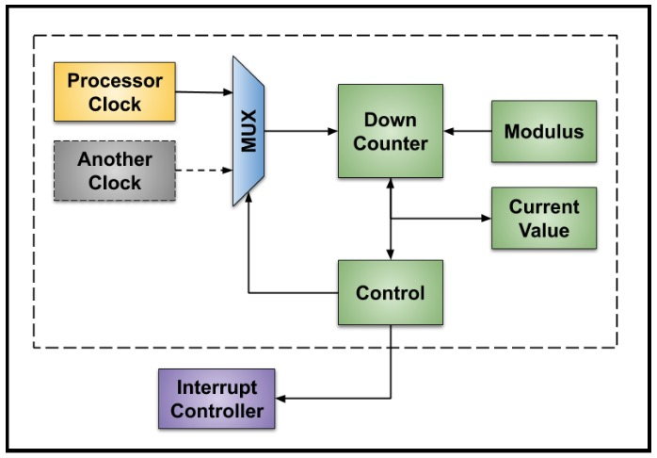
Detailed Description of a Simple, Periodic Timer

Slide 8
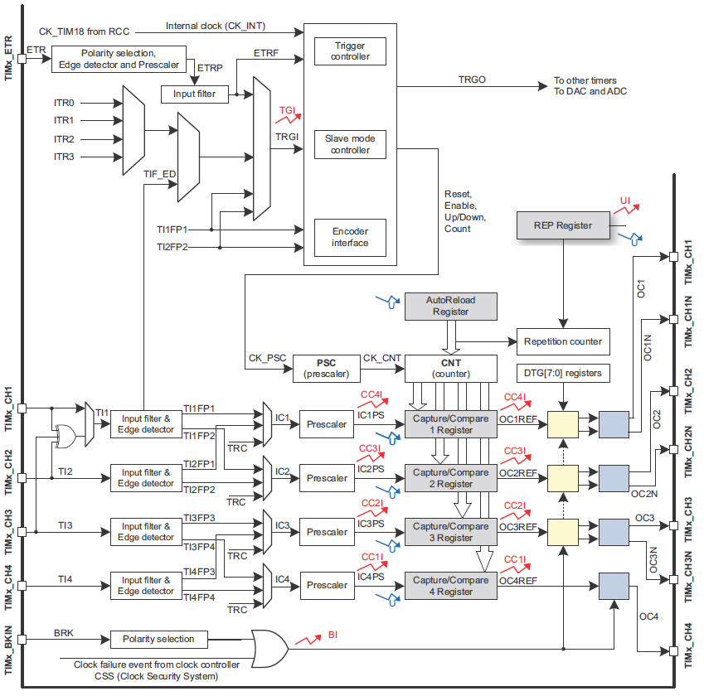
General-purpose timers

Slide 9
Timer’s registers
TIM control register 1 (TIMx_CR1)
TIM control register 2 (TIMx_CR2) TIM slave mode control register (TIMx_SMCR)
TIM DMA/interrupt enable register (TIMx_DIER)
TIM status register (TIMx_SR)
TIM event generation register (TIMx_EGR)
TIM capture/compare mode register 1/2 (TIMx_CCMR1/2)
TIM capture/compare enable register (TIMx_CCER)
TIM counter (TIMx_CNT)
TIM prescaler (TIMx_PSC)
TIM auto-reload register (TIMx_ARR)
TIM repetition counter register (TIMx_RCR)
TIM capture/compare register 1-4 (TIMx_CCR1-4)
TIM break and dead-time register (TIMx_BDTR)
TIM DMA control register (TIMx_DCR)
TIM DMA address for full transfer (TIMx_DMAR)

Slide 10
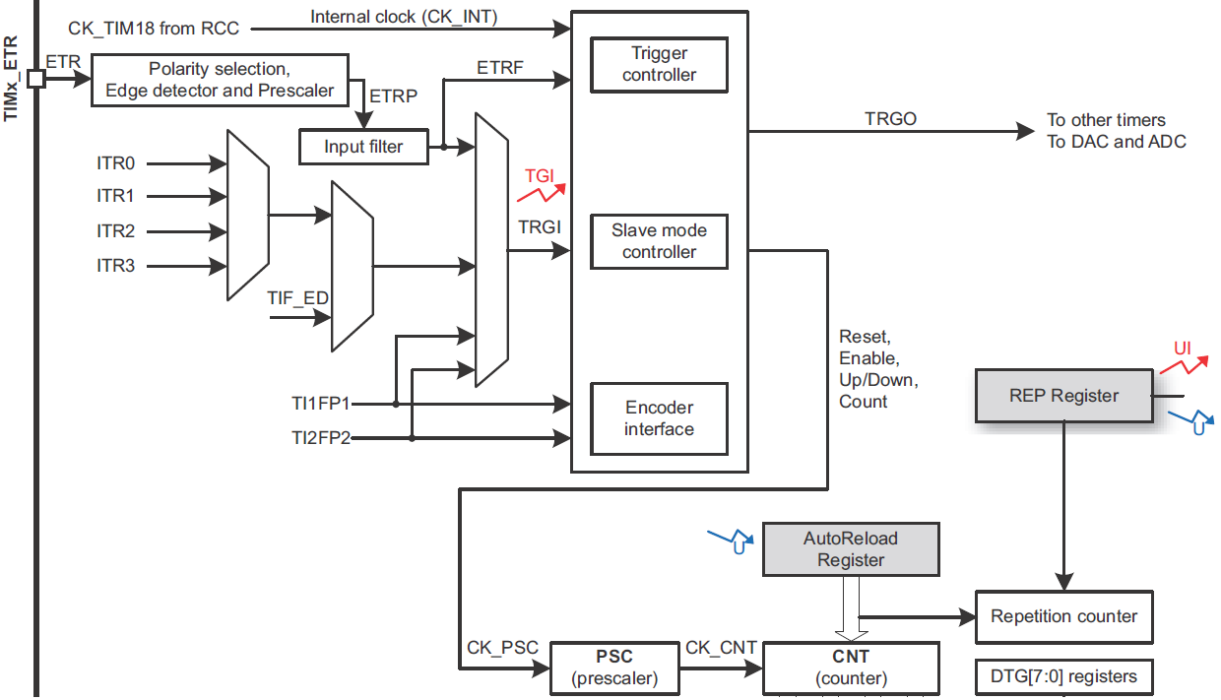
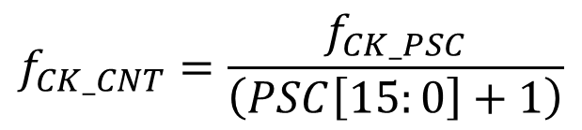
Timer’s registers
TIM prescaler (TIMx_PSC)
Address offset: 0x28
$$f_{CK_CNT}=\frac{f_{CK_PSC}}{\left(PSC\left[15:0\right]+1\right)}$$

Slide 11
Timer’s registers
TIM auto-reload register (TIMx_ARR)
Address offset: 0x2С

Slide 12
Timer’s registers
TIM counter (TIMx_CNT)
Address offset: 0x24

Slide 13
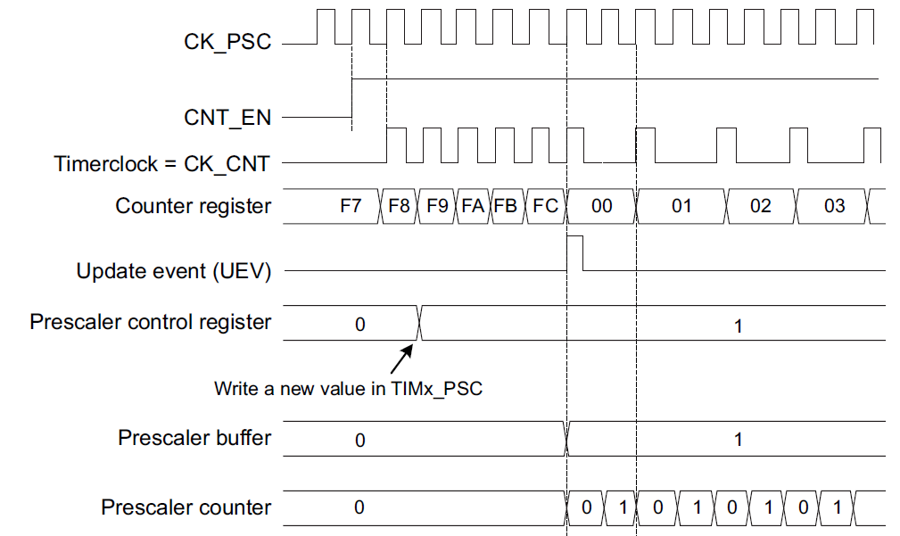
Prescaler description
ARR=0xFC

Slide 14
Timer’s registers
TIM control register 1 (TIMx_CR1)
Address offset: 0x00
CEN: Counter enable
0: Counter disabled
1: Counter enabled
OPM: One pulse mode
0: Counter is not stopped at update event
1: Counter stops counting at the next update event (clearing the bit CEN)
DIR: Direction
0: Counter used as upcounter
1: Counter used as downcounter
ARPE: Auto-reload preload enable
0: TIMx_ARR register is not buffered
1: TIMx_ARR register is buffered
CMS: Center-aligned mode selection
00: Edge-aligned mode. The counter counts up or down depending on the direction bit (DIR).
01: Center-aligned mode 1. The counter counts up and down alternatively. Output compare interrupt flags of channels configured in output (CCxS=00 in TIMx_CCMRx register) are set only when the counter is counting down.
10: Center-aligned mode 2. The counter counts up and down alternatively. Output compare interrupt flags of channels configured in output (CCxS=00 in TIMx_CCMRx register) are set only when the counter is counting up.
11: Center-aligned mode 3. The counter counts up and down alternatively. Output compare interrupt flags of channels configured in output (CCxS=00 in TIMx_CCMRx register) are set both when the counter is counting up or down.

Slide 15
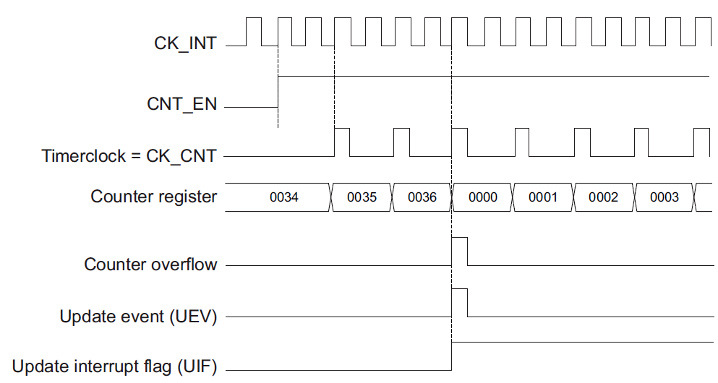
Upcounting mode

Slide 16
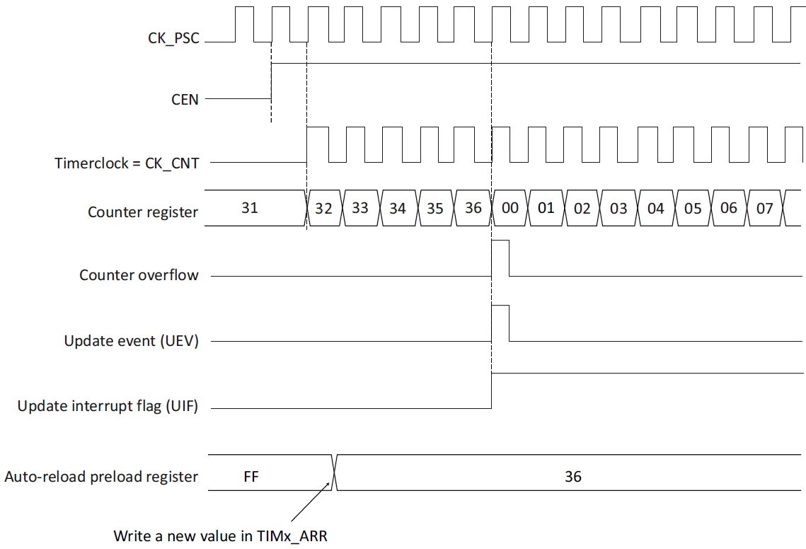
Upcounting mode
ARPE=0

Slide 17
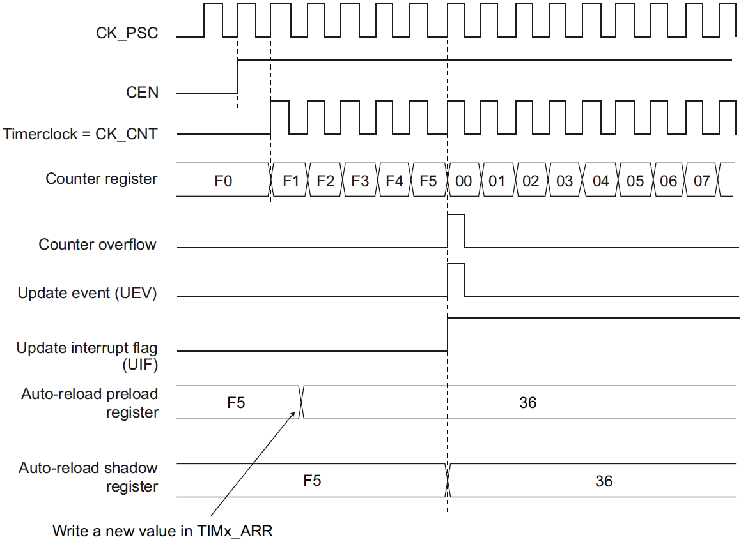
Upcounting mode
ARPE=1

Slide 18
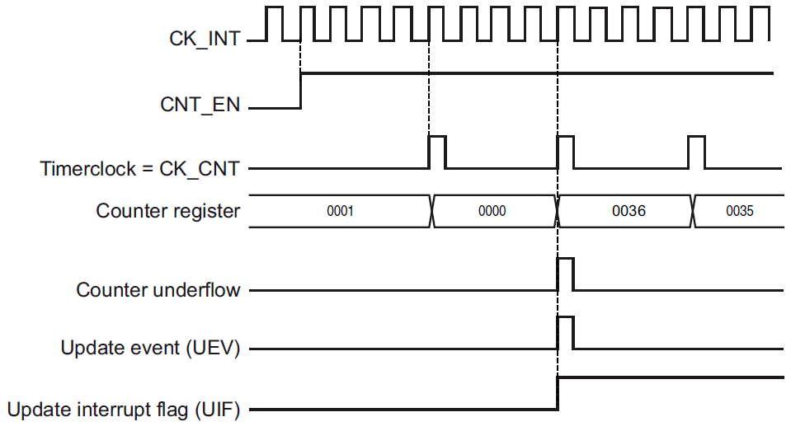
Downcounting mode

Slide 19
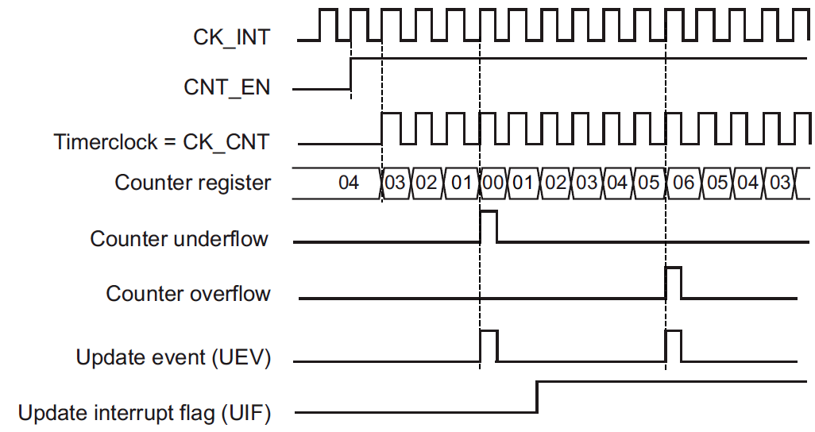
Center-aligned mode (up/down counting)

Slide 20
Timer’s registers
TIM DMA/interrupt enable register (TIMx_DIER)
Address offset: 0x0C
UIE: Update interrupt enable
0: Update interrupt disabled
1: Update interrupt enabled
CCxIE: Capture/Compare x interrupt enable
0: CC1 interrupt disabled
1: CC1 interrupt enabled

Slide 21
Timer’s registers
TIM status register (TIMx_SR)
Address offset: 0x10
UIF: Update interrupt flag
This bit is set by hardware on an update event. It is cleared by software.
0: No update occurred.
1: Update interrupt pending. This bit is set by hardware when the registers are updated
CCxIF: Capture/Compare x interrupt flag
If channel CCx is configured as output:
This flag is set by hardware when the counter matches the compare value, with some exception in center-aligned mode (refer to the CMS bits in the TIMx_CR1 register description). It is cleared by software.
0: No match.
1: The content of the counter TIMx_CNT matches the content of the TIMx_CCR1 register.
When the contents of TIMx_CCR1 are greater than the contents of TIMx_ARR, the CC1IF bit goes high on the counter overflow (in upcounting and up/down-counting modes) or underflow (in downcounting mode)
If channel CC1 is configured as input:
This bit is set by hardware on a capture. It is cleared by software or by reading the TIMx_CCR1 register.
0: No input capture occurred
1: The counter value has been captured in TIMx_CCR1 register (An edge has been detected on IC1 which matches the selected polarity)

Slide 22
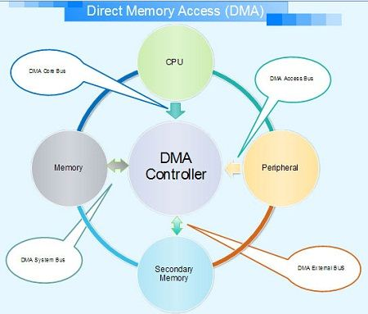
Direct Memory Access

Slide 23
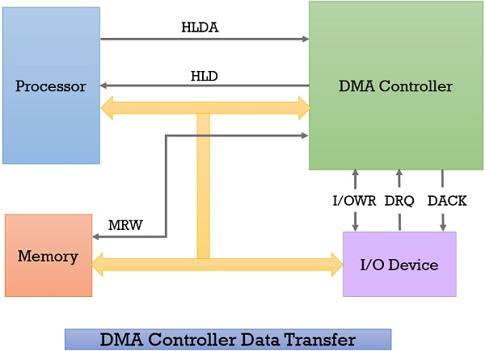
DMA Controller & its Working

Slide 24
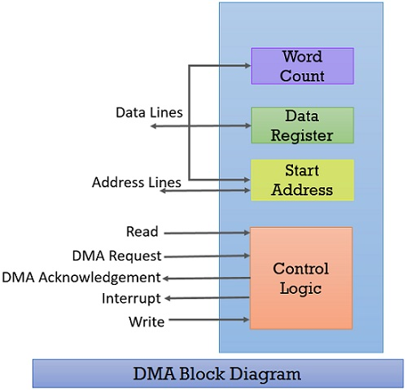
DMA Diagram

Slide 25
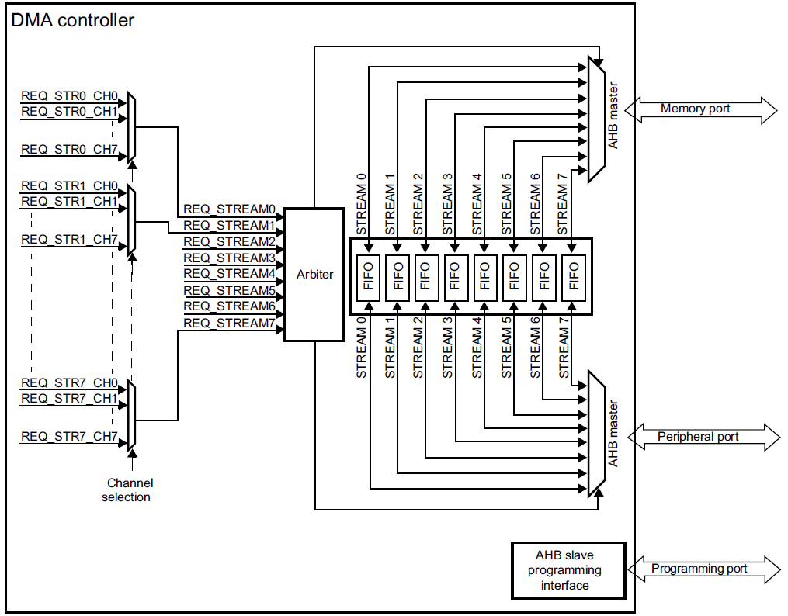
STM32 DMA

Slide 26
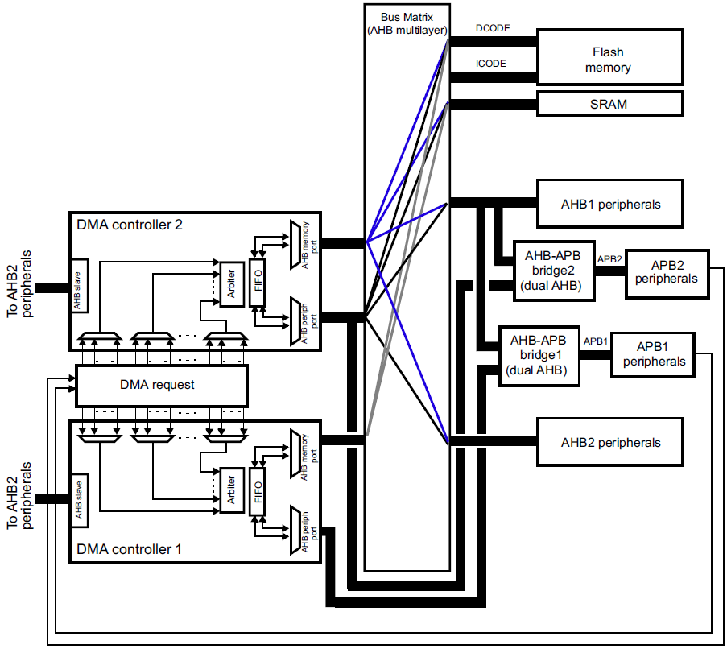
STM32 DMA

Slide 27
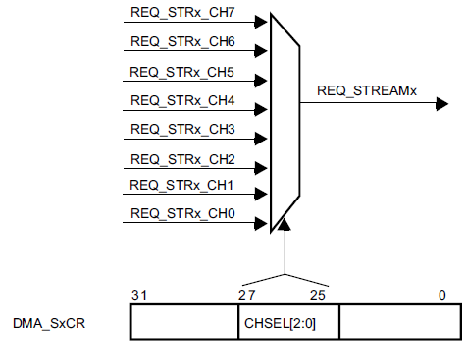
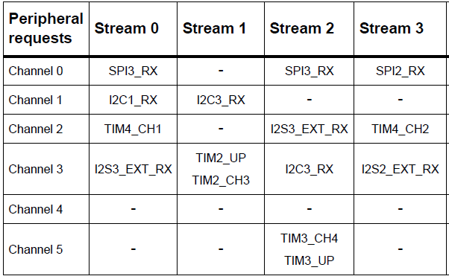
Channel selection

Slide 28
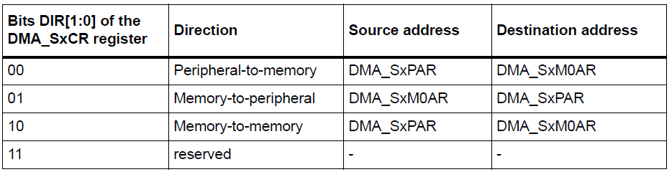
Source, destination and transfer modes

Slide 29
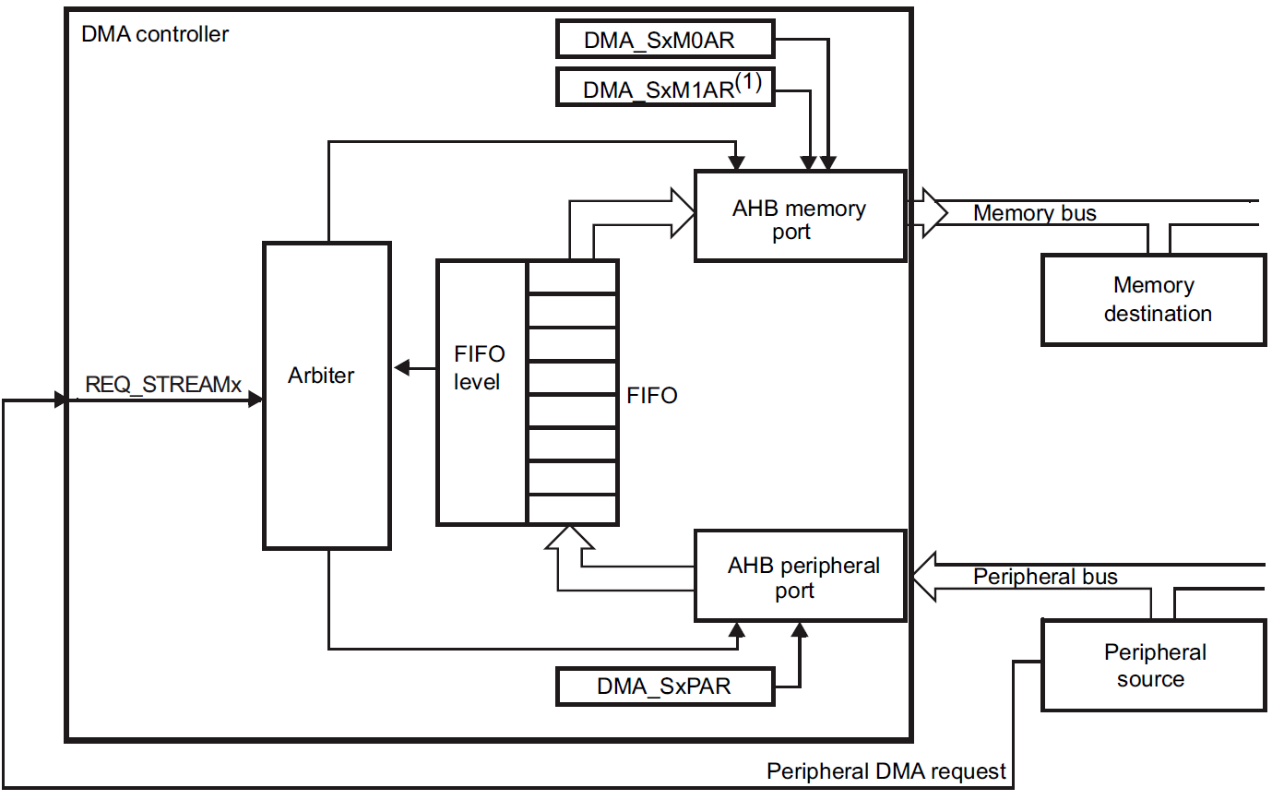
Peripheral-to-memory mode

Slide 30
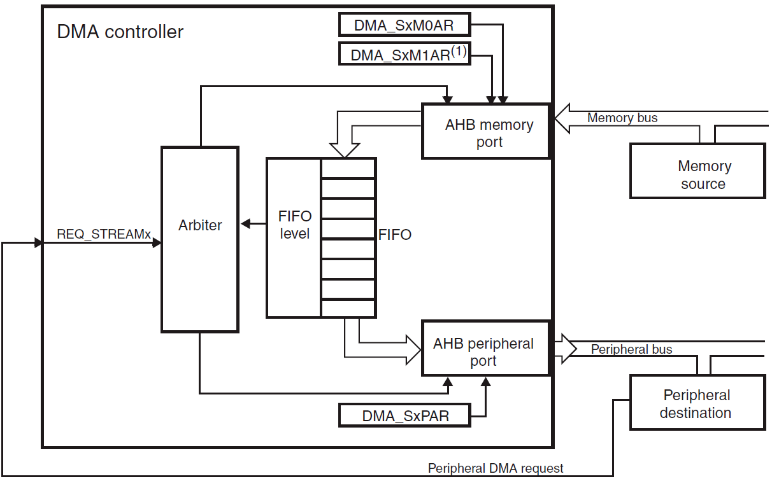
Memory-to-peripheral mode

Slide 31
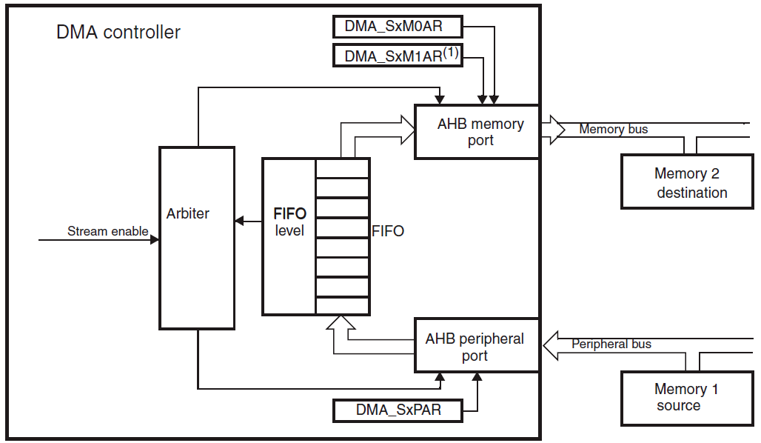
Memory-to-memory mode

Slide 32
DMA registers
DMA low/high interrupt status register (DMA_{L/H}ISR)
DMA low/high interrupt flag clear register (DMA_{L/H}IFCR)
DMA stream x configuration register (DMA_SxCR) (x = 0..7)
DMA stream x number of data register (DMA_SxNDTR) (x = 0..7)
DMA stream x peripheral address register (DMA_SxPAR) (x = 0..7)
DMA stream x memory 0 address register (DMA_SxM0AR) (x = 0..7)
DMA stream x memory 1 address register (DMA_SxM1AR) (x = 0..7)
DMA stream x FIFO control register (DMA_SxFCR) (x = 0..7)

Slide 33
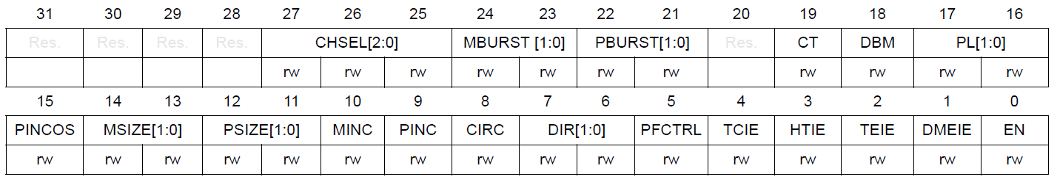
DMA registers
DMA stream x configuration register (DMA_SxCR) (x = 0..7)
Address offset: 0x10 + 0x18 * stream number
EN: stream enable
This bit is set and cleared by software.
0: stream disabled
1: stream enabled
{DME/TE/HT/TC}EI: direct mode error/transfer error/half transfer/transfer complete interrupt enable
0: interrupt disabled
1: interrupt enabled
DIR: data transfer direction
00: peripheral-to-memory
01: memory-to-peripheral
10: memory-to-memory
11: reserved
{P/M}INC: peripheral/memory increment mode
0: address pointer is fixed
1: address pointer is incremented after each data transfer (increment is done according to PSIZE)
{P/M}SIZE: peripheral/memory data size
00: byte (8-bit)
01: half-word (16-bit)
10: word (32-bit)
11: reserved
CHSEL: channel selection
000: channel 0 selected
001: channel 1 selected
010: channel 2 selected
011: channel 3 selected
100: channel 4 selected
101: channel 5 selected
110: channel 6 selected
111: channel 7 selected

Slide 34
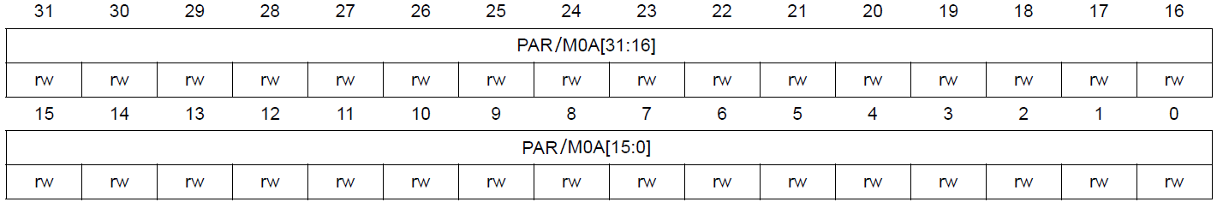
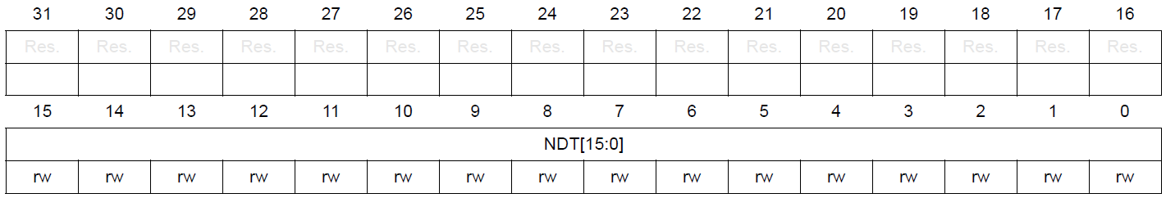
DMA registers
DMA stream x peripheral/memory 0 address register (DMA_Sx{P/M0}AR) (x = 0..7)
Address offset: 0x18/0x1C + 0x18 * stream number
DMA stream x number of data register (DMA_SxNDTR) (x = 0..7)
Address offset: 0x14 + 0x18 * stream number

Slide 35
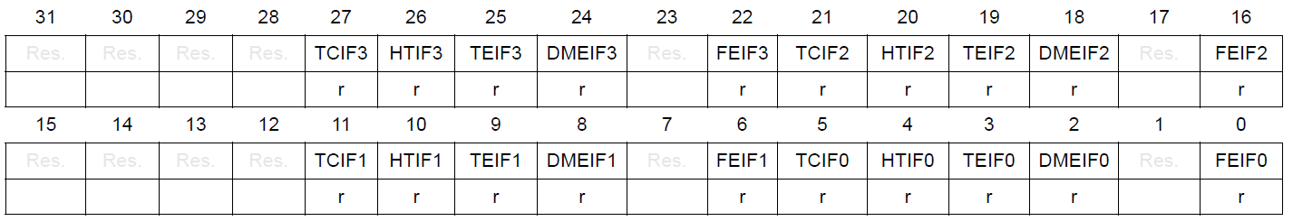
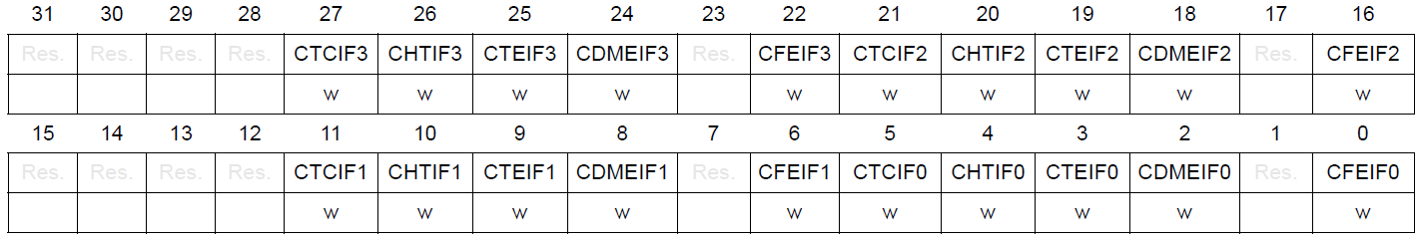
DMA registers
DMA low/high interrupt status register (DMA_{L/H}ISR)
DMA low/high interrupt flag clear register (DMA_{L/H}IFCR)
Address offset: 0x00, 0x04, 0x08, 0x0C
FEIFx: stream x {clear} FIFO error interrupt flag
DMEIFx: stream x {clear} direct mode error interrupt flag
TEIFx: stream x {clear} transfer error interrupt flag
HTIFx: stream x {clear} half transfer interrupt flag
TCIFx: stream x {clear} transfer complete interrupt flag

Slide 36
DMA Enable algorithm
Steps for start DMA transfer
Enable DMA transfer in peripheral device.
Config DMA stream:
Select peripheral channel.
Set transfer direction.
Set increase mode for memory or peripheral, if required.
Enable events interrupts, if required.
Set peripheral address, memory address and number of bytes for transfer.
Start transfer by enabling DMA Stream.

Slide 37
DMA Example
uint8_t tx_data[10];
int main()
{ RCC->APB1ENR |= RCC_APB1ENR_USART2EN;
RCC->AHB1ENR |= RCC_AHB1ENR_DMA1EN;
USART2->BRR = APB1/USART_BAUDRATE;
USART2->CR1 = USART_CR1_UE | USART_CR1_TE | USART_CR1_RE;
USART2->CR3 = USART_CR3_DMAT;
DMA1_Stream6->CR = DMA_SxCR_DIR_0 | DMA_SxCR_MINC | DMA_SxCR_CHSEL_2;
DMA1_Stream6->PAR = (uint32_t) &USART2->DR;
DMA1_Stream6->M0AR = (uint32_t) &tx_data;
DMA1_Stream6->HIFCR = DMA_HIFCR_CTCIF6 | DMA_HIFCR_CHTIF6;
DMA1_Stream6->NDTR = 10;
DMA1_Stream6->CR |= DMA_SxCR_EN;
}

Slide 38

Thank you for attention
www.ifmo.ru

